Slide 1
User Input and Forms

Slide 2
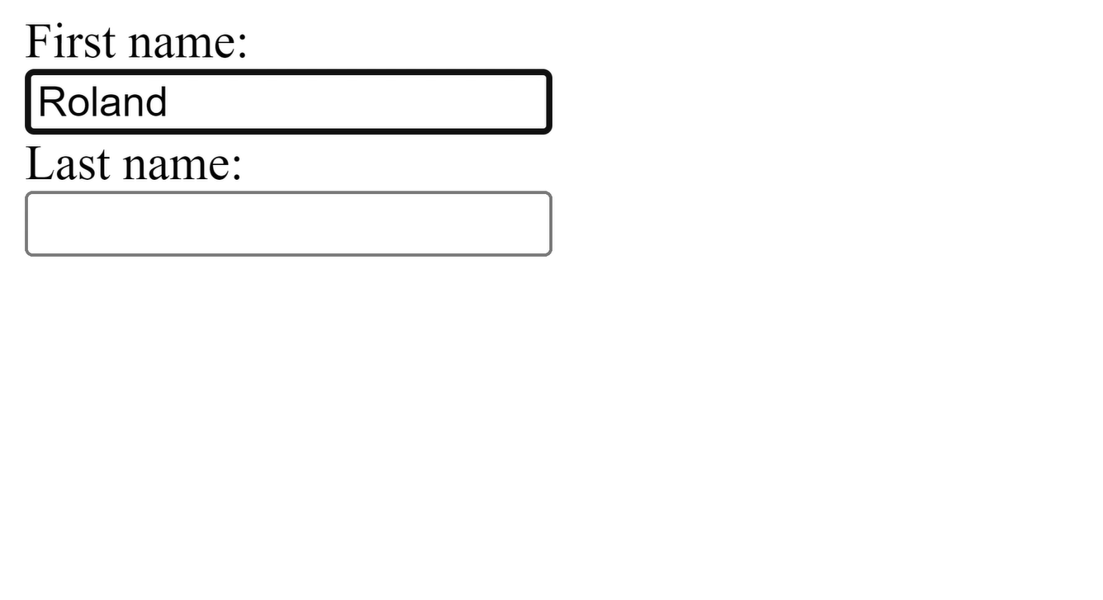

Slide 3
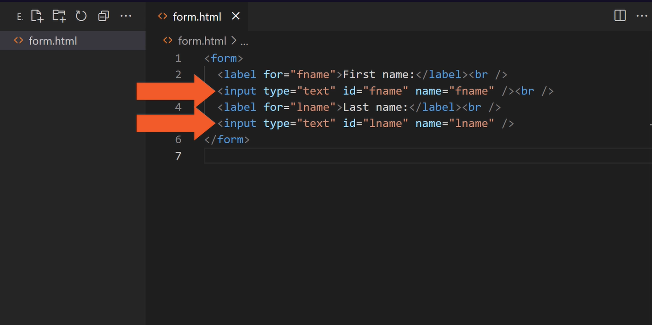

Slide 4
Write code that gets references to the input elements
Forms in JavaScript Applications
Extract current values
Post to API
Convert internal state to React state Controlled components

Slide 5
A Controlled Component (1/2)
const [ firstname, setFirstname ] = useState("Alice");
return (
<input type="text" value={firstname} />
);

Slide 6
A Controlled Component (2/2)
const [ firstname, setFirstname ] = useState("Alice");
return (
<input type="text" value={firstname}
onChange={(e) => setFirstname(e.target.value)} />
);

Slide 7
Controlled Components and Forms
const [ firstname, setFirstname ] = useState("Alice"); const submit = (e) => {
e.preventDefault();
//submit firstname to API
};
return (
<form onSubmit={submit}>
<input type="text" value={firstname}
onChange={(e) => setFirstname(e.target.value)}
/>
</form>
);

Slide 8
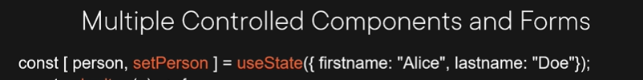
const submit = (e) => { e.preventDefault();
//submit person to API
};
return (
<form onSubmit={submit}>
<input type="text" value={person.firstname} onChange={(e) => setPerson({ …person, firstname:
e.target.value})} />
<input type="text" value={person.lastname} onChange={(e) => setPerson({ …person, lastname:
e.target.value})} />
</form>

Slide 9
A Common onChange Handler
const [ person, setPerson ] = useState({ firstname: "Alice", lastname: "Doe"});
const change = ((e) => setPerson({ …person, [e.target.name]: e.target.value });
return (
<form onSubmit={submit}>
<input type="text" name="firstname" value={person.firstname} onChange={change}/>
<input type="text" name="lastname" value={person.lastname}
onChange={change} />
</form>
);)

Slide 10
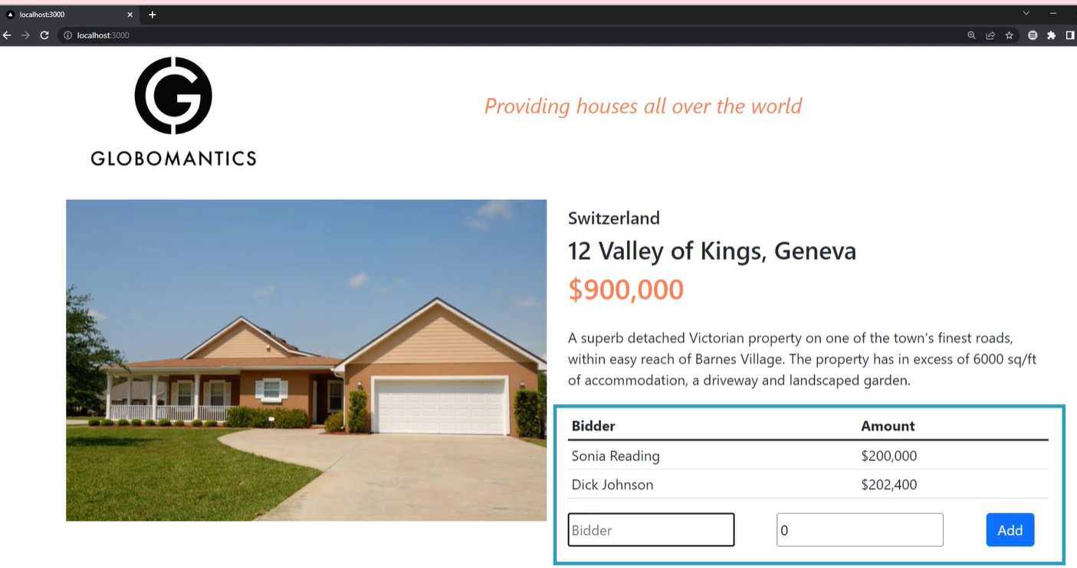

Slide 11
textarea
HTML:
<textarea> Some text
</textarea>
React component:
<textarea value={state} onChange={change} />

Slide 12
select
HTML:
<select>
<option value="option1">1</option>
<option selected value="option2">2</option>
</select>
React component:
<select value={state} onChange={change} >
<option value="option1">1</option>
<option value="option2">2</option>
</select>

Slide 13
Controlled is the way to go
But work involved
Uncontrolled Components
When converting preexisting codebase
Quick and dirty Temporary

Slide 14
An UnControlled Component
const Form = () => {
const inputEl = useRef(null); const submit = (e) => {
e.preventDefault();
const inputValue = inputEl.current.value;
//process inputValue
};
return (
<form onSubmit={submit}>
<input ref={ inputEl } type="text" />
<input type="submit" value="Submit" />
</form>
);
};

Slide 15
UnControlled Components: defaultValue
<input ref={ inputEl } type="text" defaultValue={val} />

Slide 16
File Input
const Form = () => {
const inputEl = useRef(null); const submit = (e) => {
e.preventDefault();
const selectedFile = inputEl.current.files[0].name;
//process selectedFile
};
return (
<form onSubmit={submit}>
<input ref={ inputEl } type="file" />
<input type="submit" value="Submit" />
</form>
);
};

Slide 17
Validation
Error messages
Adding Form Functionality
Handling form submission
State handling
External library Formik (formik.org)

Slide 18
Next up:
Application Design

